Slide 1
Exploratory Data Analysis
On Google Play Store App Dataset

Slide 2
About the Dataset
Source :
https://www.kaggle.com/moinuddinmaruf/google-play-app-rating-analysis
EDA GitHub :
https://github.com/Harsha-code1/data-science-bootcamp/tree/main/EDA_Google_Playstore_dataset

Slide 3
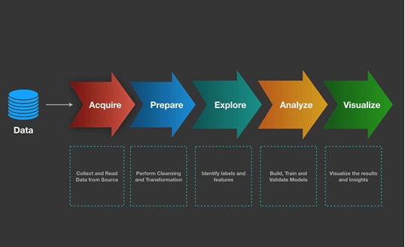
Workflow of Data Analysis
Learn about the Data Set
Handle the missing values
Finding the numerical / categorical values
Distribution of numerical values
Outliers
Relationship between independent and dependent variable

Slide 4
Steps Involved
Load the dataset
Read the dataset
Data cleaning
Data imputation and manipulation
Data Visualization

Slide 5
Thank You

